Slide 1
Spotify Analysis Dashboard
This Spotify Analysis Dashboard in Power BI provides insights into streaming trends, top artists, and song performances. It includes key metrics like total streams, average streams per year, and the percentage of top song streams compared to the average. Visuals include a bar chart for track-wise streams, a pie chart for the top 10 artists, and a timeline of track releases. The dashboard helps users explore streaming patterns, artist popularity, and song energy levels efficiently.

Slide 2
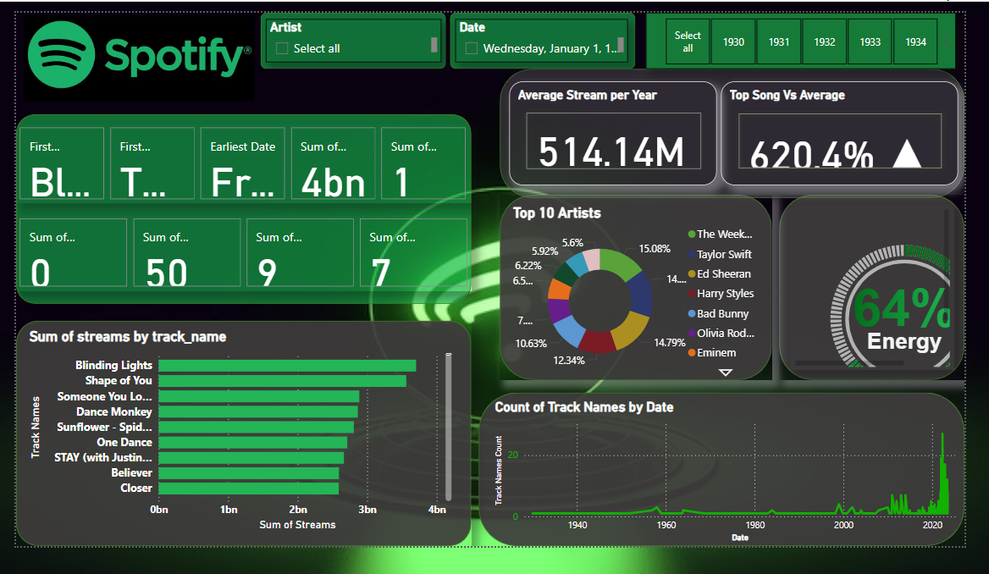
The overall Dashboard of this project

Slide 3
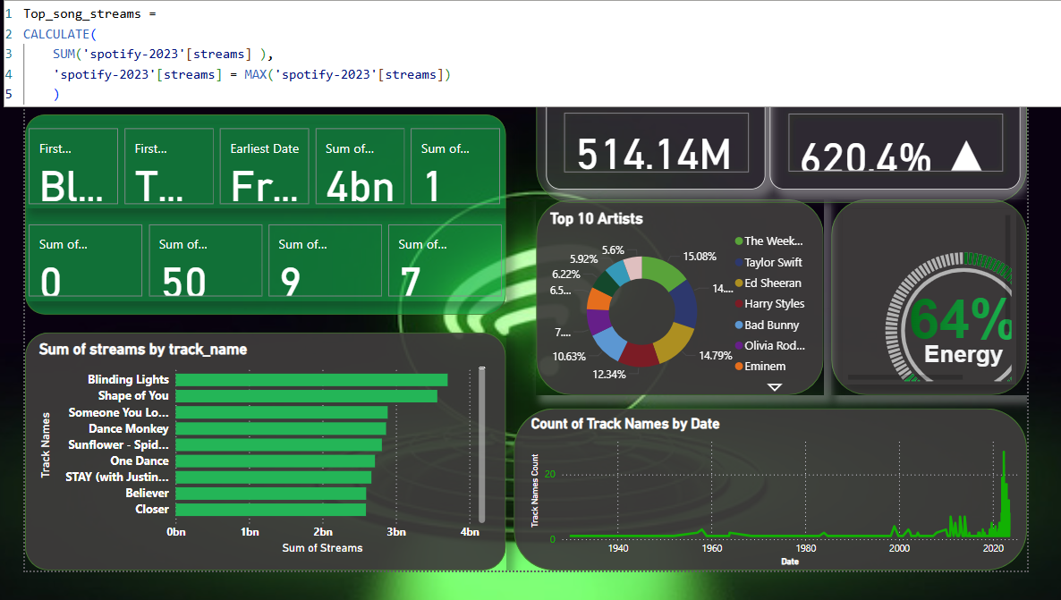
Top Songs
The dashboard showcases the most streamed songs, with "Blinding Lights" leading, followed by "Shape of You," "Someone You Loved," and others. A bar chart visualizes their total streams, highlighting their dominance in the streaming charts.

Slide 4
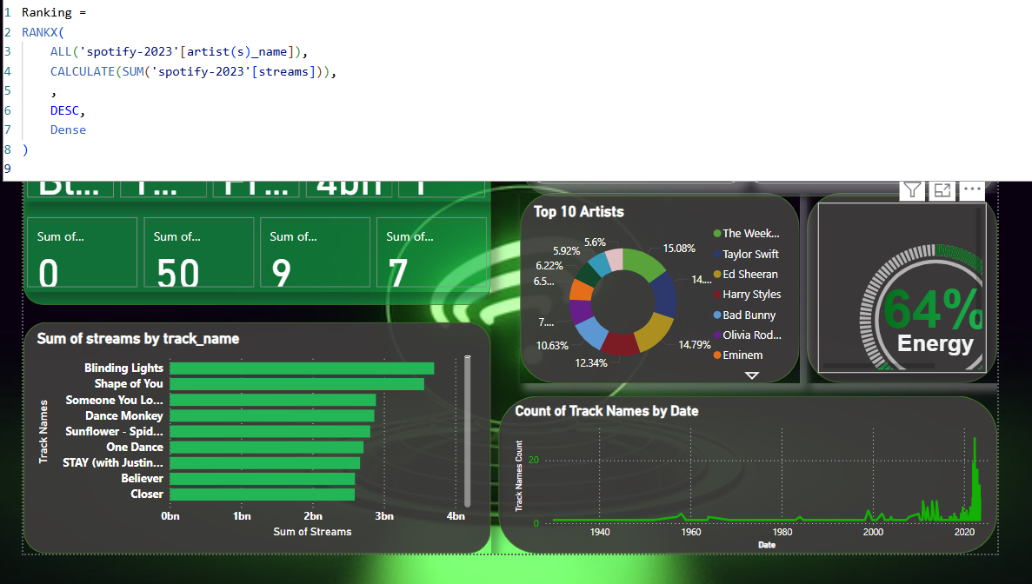
Ranking
The dashboard ranks songs based on total streams, with "Blinding Lights" holding the top position, followed by other hits like "Shape of You" and "Someone You Loved." The ranking helps identify the most popular tracks in the dataset.

Slide 5
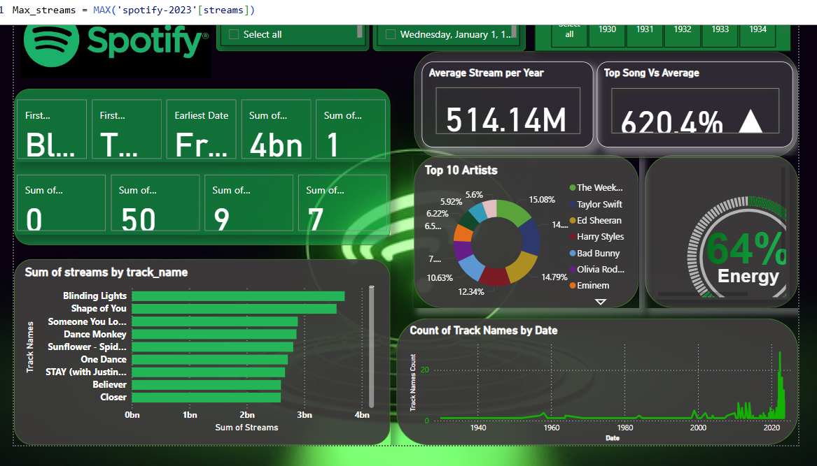
Max Stream
The highest-streamed song, "Blinding Lights," surpasses 4 billion streams, making it the most popular track in the dataset. The dashboard compares it with other top songs and the average stream count.

Slide 6
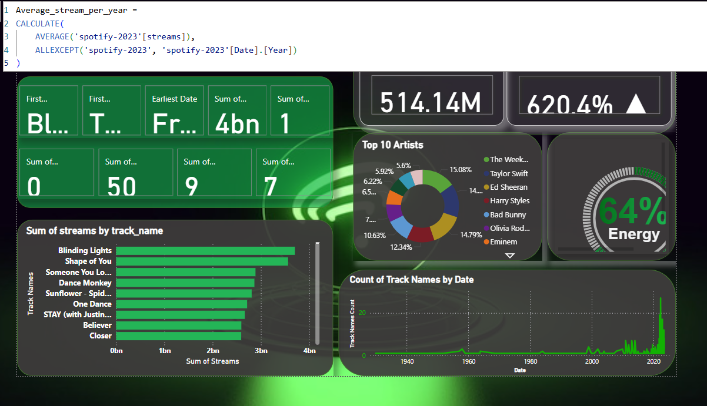
Average
The dashboard calculates the average streams for each song on specific dates and years. It highlights trends in streaming patterns, showing how certain songs gained popularity in particular years, with a focus on annual performance averages.

Slide 7
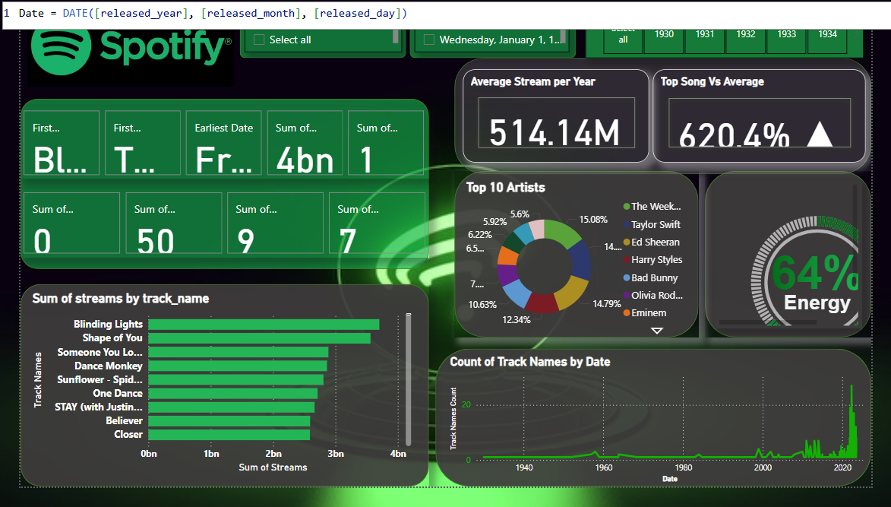
Date
The dashboard tracks song streams over specific dates, highlighting peak streaming periods and identifying key dates with the highest stream counts.

Slide 8
Project Overview
This dashboard provides an in-depth analysis of Spotify streaming data, showcasing top songs, artist performance, and stream trends over time. Key metrics include total streams, song rankings, and average streams by year. Visuals like bar charts and pie charts allow users to explore streaming patterns, top tracks, and artist popularity, offering valuable insights into listener preferences.

Slide 9
Thank You!!

